Slide 1
Decoding Recipe Popularity
Tasty bytes

Slide 2
Project Objectives
Predict recipes That Drive High Traffic
Achieve 80% Accuracy in Popularity Prediction
Boost Website Engagement & Subscriptions

Slide 3
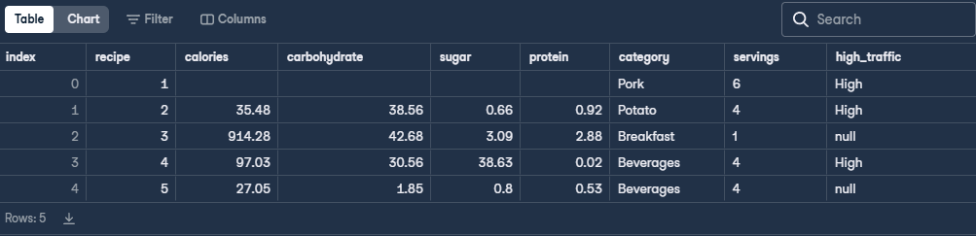
Data

Slide 4
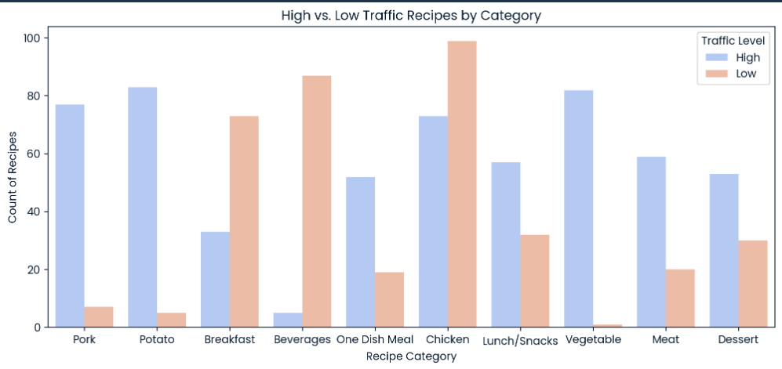
Key Findings
Few categories of recipes had substantially high traffic rates, namely:
Vegetable
Potato
Pork

Slide 5
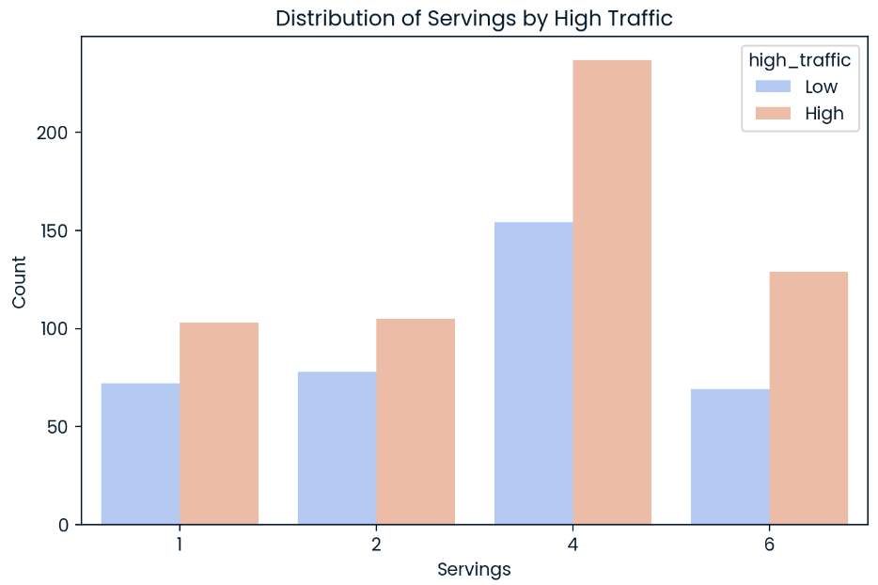
Key Findings
Serving portion lacks strong correlation with traffic. More data or features needed for better prediction.

Slide 6


Modeling

Slide 7
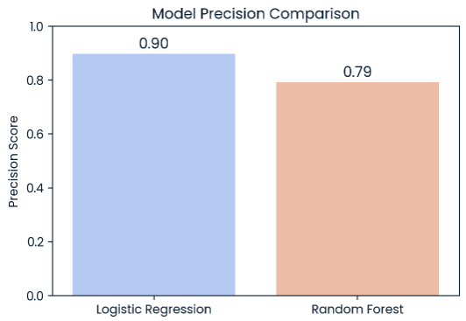
Metrics

Slide 8
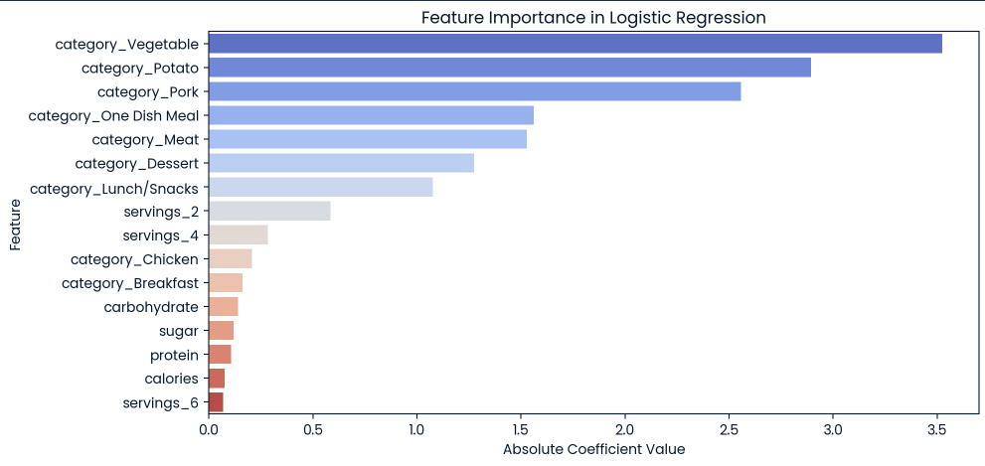
Feature Importances

Slide 9
Recommendations
Prioritize High-Traffic Categories – Feature more Vegetable, Pork, and Potato recipes to boost engagement.
Leverage Nutritional Insights – Track Calories, Carbs, and Sugar to align with user preferences.
Enhance Model Accuracy – Optimize Logistic Regression with hyperparameter tuning and explore additional data points.

